Slide 1
RESPONSE TO
Covid-19
Together
we serve
better...
Sewa International, USA
P.O. Box 820867, Houston
TX 77282-0867, Tax ID: 20-0638718
info@sewausa.org
708-USA-SEWA
www.sewausa.org

Slide 2
Six-pronged approach to deliver services
MEDICAL SUPPLIES
Community
Education
NON MEDICAL
HELP LINE
8 Helplines serving via 43 chapters in the USA
Supply personal protective equipment (PPE) to healthcare workers and other essential services personnel
Conduct periodic webinars with physicians, therapists, immigration attorneys, and other professionals
CASE MANAGEMENT
INTERNATIONAL STUDENTS
SENIOR CITIZENS
Support individuals & families requiring long term assistance (mental health, counseling & domestic issues)
Support international students & stranded travelers: food, shelter, travel queries & financial assistance.
Support elderly & vulnerable population by delivering essentials: cooked food, groceries, meds, etc.

Slide 3
Sewa COVID-19 Relief
Functional
Helpline
Case Management
Procure PPE & Mask Making
Geographical
International Students / Stranded Passengers
Senior & Vulnerable Populations
Travel/ Visa
***
Board/ Lodge
***
Loans
*
Operations
***
Supply Chain
***
Delivery (Groc., Food, Meds)
***
Community Education Webinars
Topics of Interest
***
Funerals ***
Mental Health & Spiritual Counseling
***
Domestic Issues
***
Plasma Registry
***
*** Operational ** Under Construction * Conceptual Stage

Slide 4
2,500+
VOLUNTEERS
Engaged
via 43 Chapters
50+
ORGANIZATIONS
MOBILIZED FOR SUPPORTING LOCAL Food Banks
$500,000+
AMOUNT
Raised for COVID-19
relief efforts
800+
ORGANIZATIONS
Reached through PLEDGE FOR SERVICE campaign

Slide 5
300,000+
N95, KN95,
SURGICAL MASKS
DISTRIBUTED
1000+
LITERS OF
SANITIZER DISTRIBUTED
4000+
HOT MEALS
PER WEEK
$100,000
DONATED TO
FOOD PANTRIES

Slide 6
300+
200+
600+
VOLUNTEERS
TRAINED
STUDENTS &
STRANDED TRAVELERS
BULK FOOD
DELIVERIES
8 HELPLINE CENTERS
8 am - 11 pm Daily
24x7 for
Plasma
Supported
accommodation, food/grocery, travel, etc.
For police, caregivers, doctors, senior citizens, etc.
750+ CALLS 500+ WHATSAPP ENQUIRIES
38% Medical & Health Issues
20% Grocery & Food Requests
13% Travel Related Info
13% Other General Inquiries
08% Immigration/Visa Issues
08% Volunteering
50+
100+
FAMILY
SERVICES
PHYSICIANS
& ATTORNEYS
Medical, Funeral,
Hospitalization Cases, etc.
For guidance and
support

Slide 7
PLEDGE FOR SERVICE
To bring together Community Service Organizations in the USA on a ‘Pledge for Service’ by providing
non-Medical COVID-19 support to care for community members.
225 SIGNED THE SEWA SANKALPA PATRA
SANYAM
SAHAKAR
(Self-restraint)
(Cooperation)
SAHAYOG
(Collaboration)

Slide 8
MISSION
MASK MAKING
500+
VOLUNTEERS
making HOMEMADE
PROTECTIVE MASKS
16,000+
HOME MADE
MASKS DISTRIBUTED

Slide 9
PLASMA DONATION
75 DONORS, 30 RECIPIENTS
4 REGISTRY MATCHES
24/7 HOTLINE
ONLINE REGISTRATION
FOR VOLUNTEERS & PATIENTS
www.sewacovidplasma.org

Slide 10
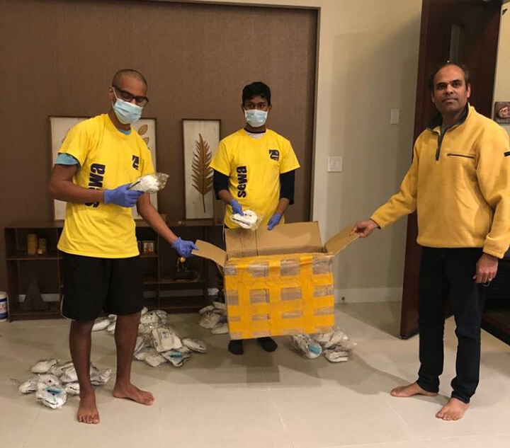
MEDIA COVERAGE
77
WEBINARS
50
Awareness Campaign Posters
200,000+
Reached through Social Media
75K+
VIEWERS

